Slide 1

Arbor Robotics
Project Management Review Presentation
Presented By Team H
04 September 2024

Slide 2
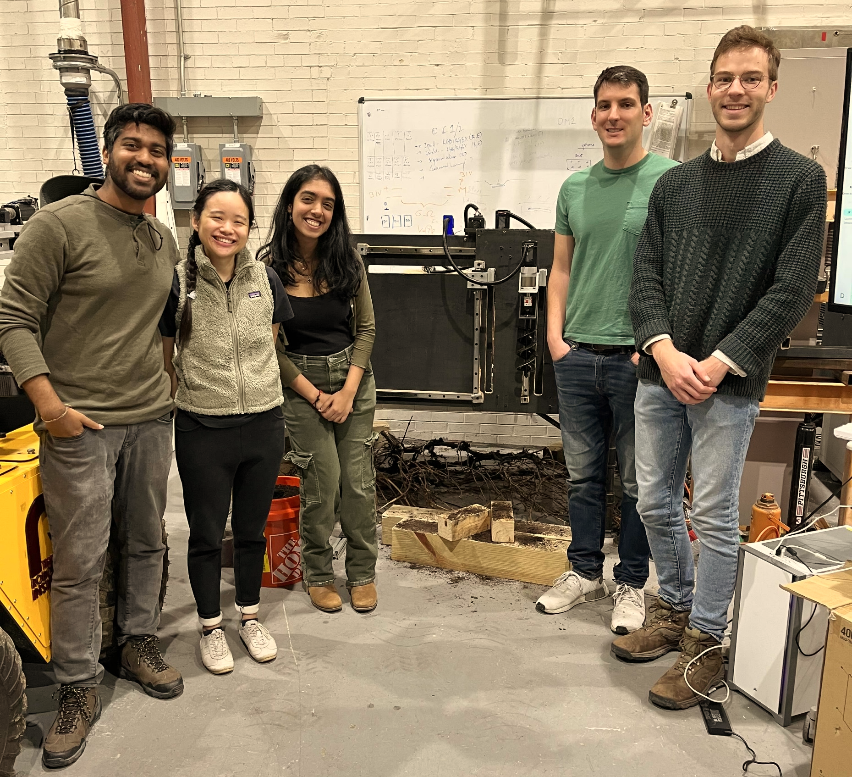

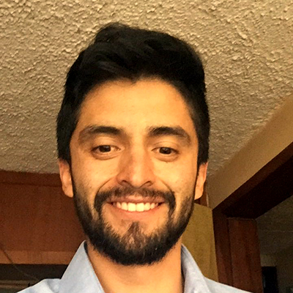
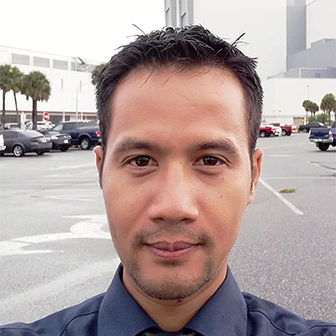
Arbor Robotics
And the people who helped us along the way!
Here’s the team.

Slide 3
Project Description
Trees. And how to make planting them more accessible.

Slide 4
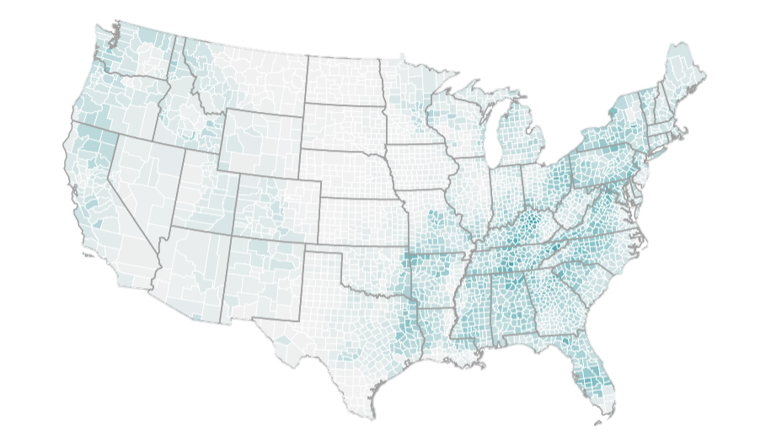

The Problem
A lot of land that could be reforested isn’t. Why?
Work is extremely laborious, potentially dangerous, time consuming, and involve delicate payloads
Pastureland is too large for private landowners to plant trees themselves
Pastureland is too small for contractors to take it as a project

Slide 5
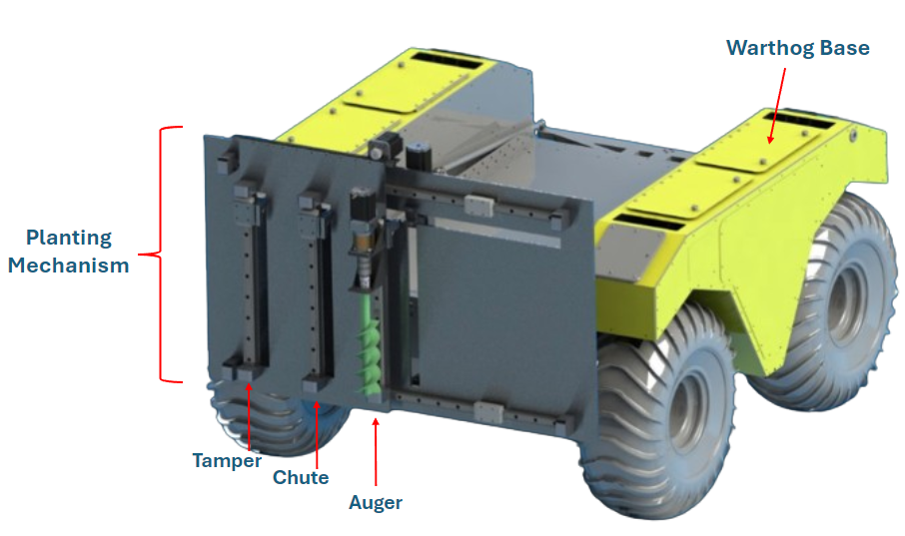
Eligible Forest Land
148 million acres of total opportunity in the U.S. alone.
Roughly half is pasture.
10% of pasture reforested = 25.8 million tons CO2/year
That’s 5.6 million cars
(NY has 3.1 million cars)

Slide 6
Our Solution
Plants trees economically and conveniently on marginal pastureland
Fills massive gap between DIY and commercial planting sizes
Can be extended to other planting zones, e.g. urban, in the future

Slide 7
Technical Development
Where we are and how far we need to go

Slide 8
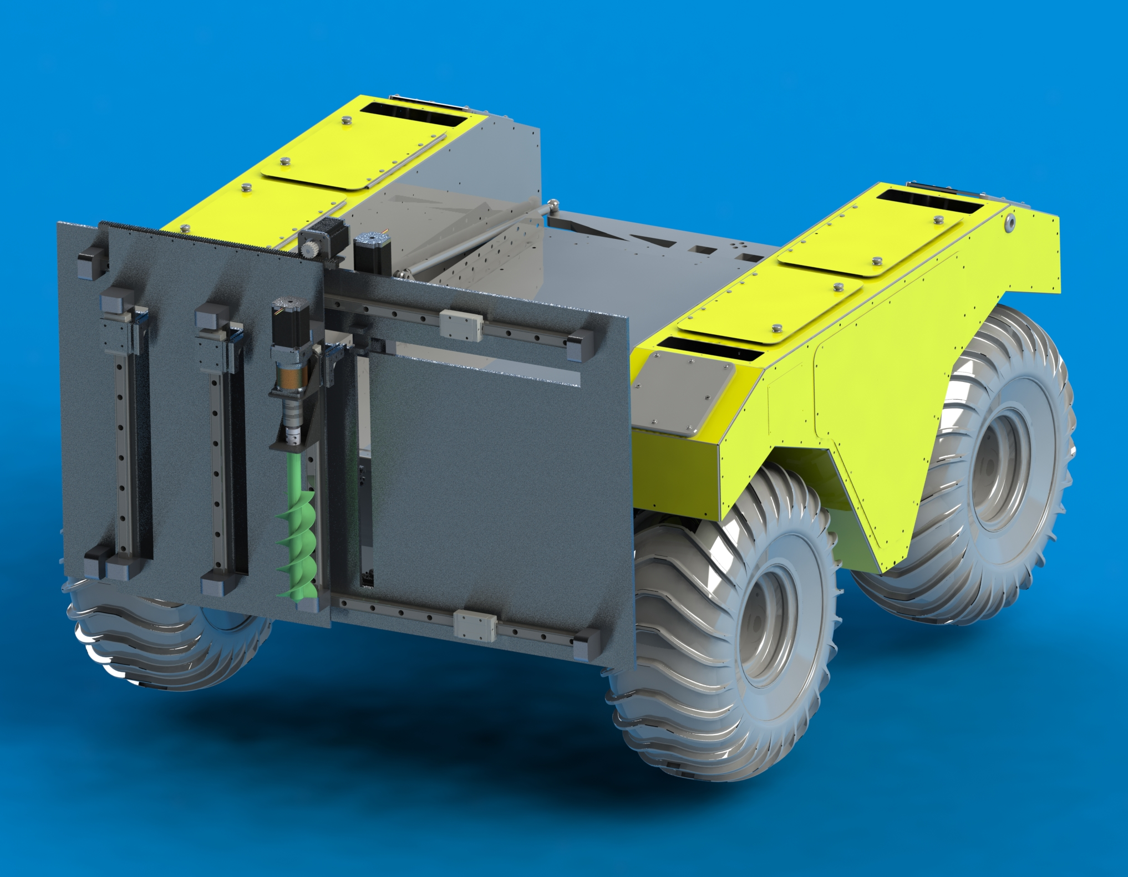
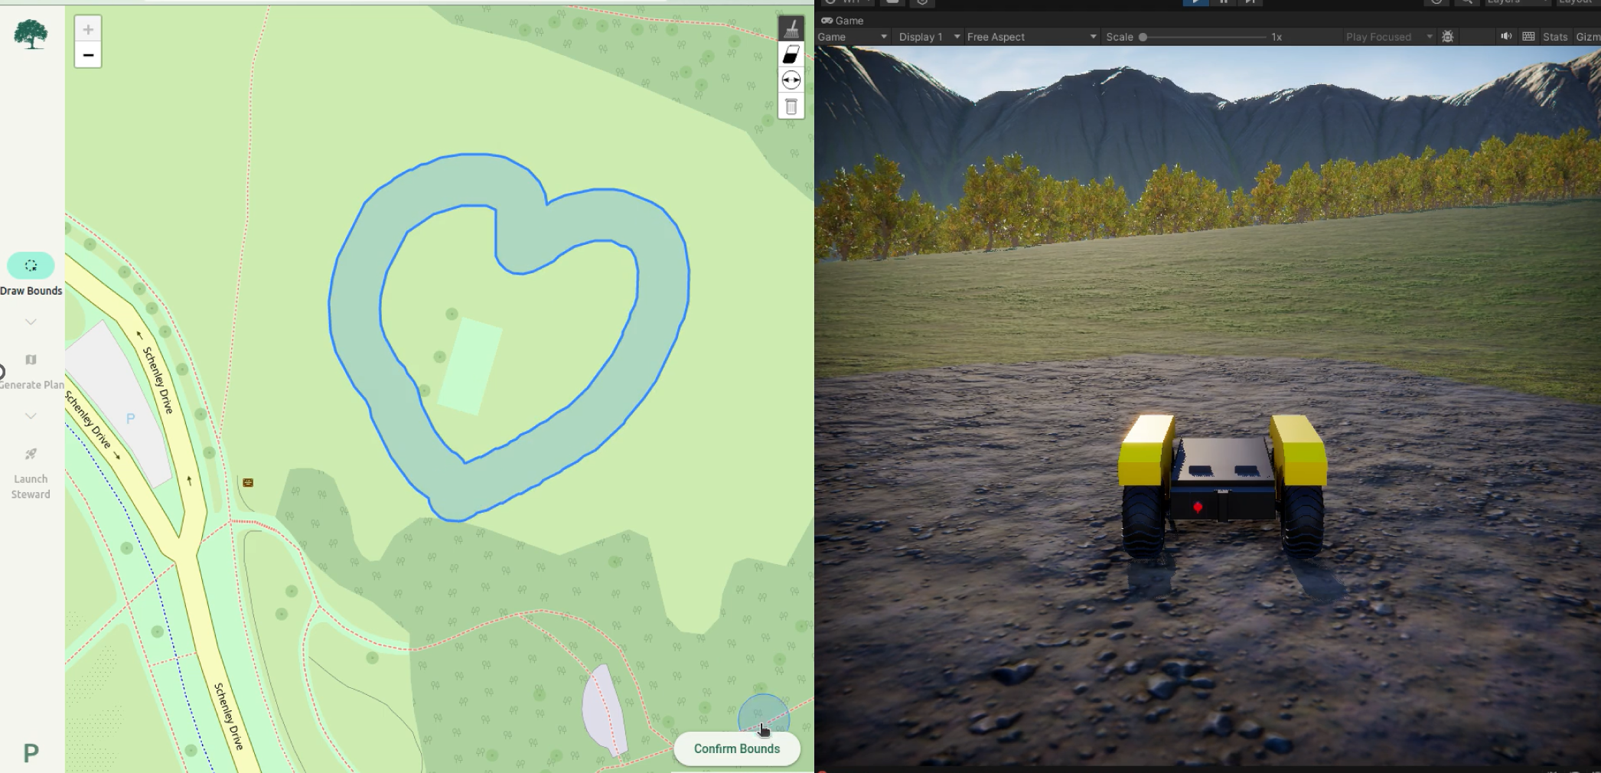
Subsystem Description
Mechanical & Electrical
Software & Navigation

Slide 9
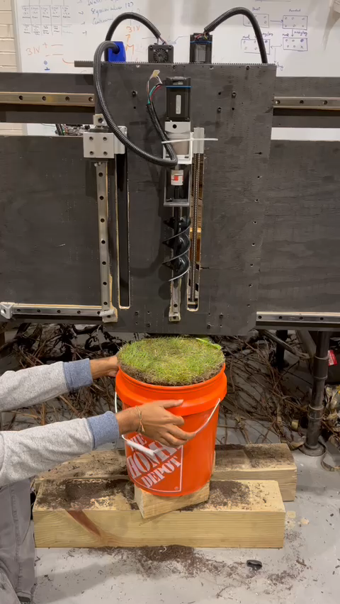
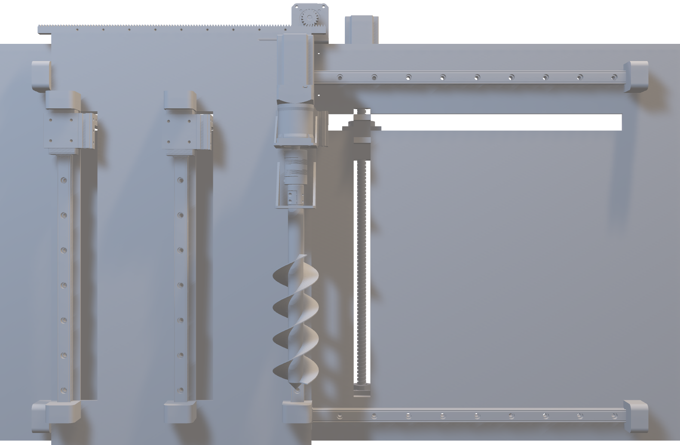
Subsystem Status: Mechanical & Electrical
Current Status on the right.
Pending Tasks
Fabricate Chute & Tamper Implements
Incorporate Limit Switches & Current Sensors
Iterate existing components
Install on Warthog

Slide 10
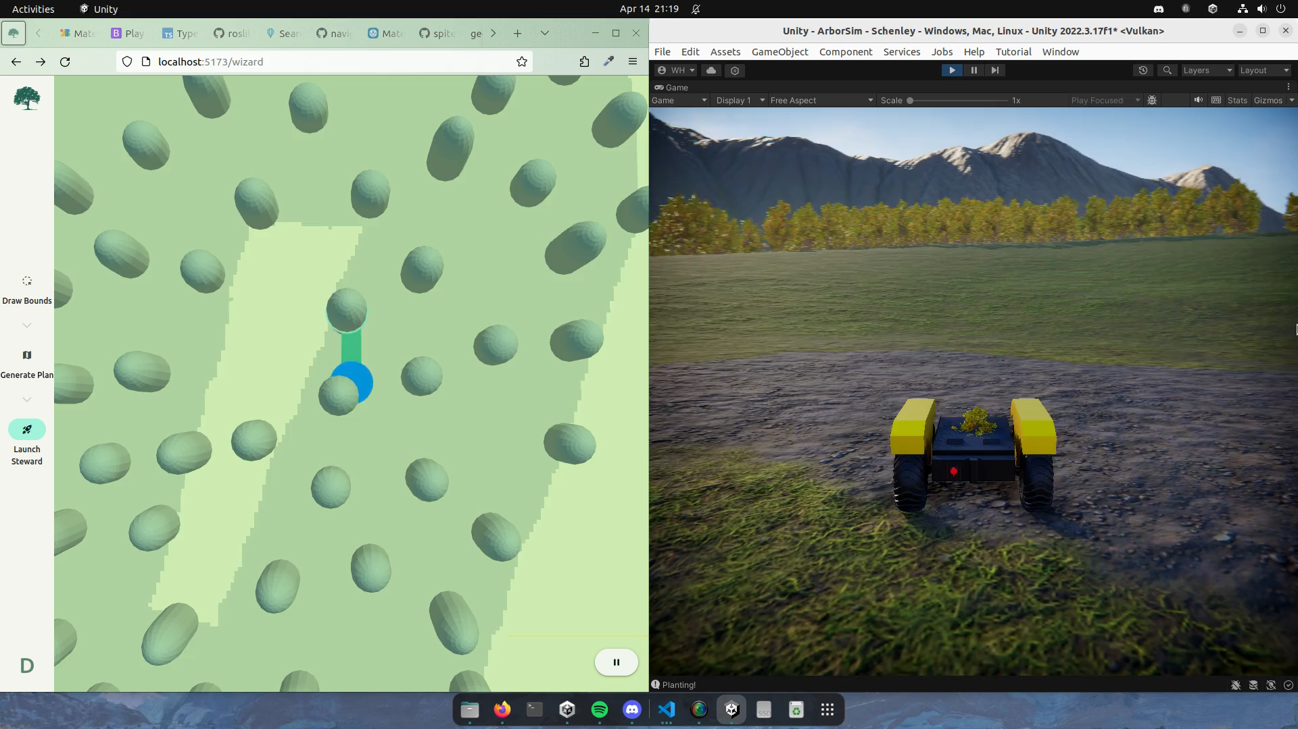
Subsystem Status: Navigation & User Interface
Current Status on the right.
Pending Tasks
Interface S/W with Warthog
Incorporate GNSS
Integrate obstacle avoidance w/ RGBD camera
Feed information back to User Interface real time

Slide 11
Subsystem Status
Planting Mech
45%
Electronics for Mech
33%
Software for Mech
60%
Navigation
75%
Electronics for Nav
20%
User Interface
80%
Integration
50%
Planting Mechanism Fabrication
Three implements that all must work in tandem
Transferring from Simulation to Real World
Different sensors/cameras than in unity & limited Warthog access
Plan: Start ROS connectivity and plan for early field testing
Integration of two subsystems
Issues with combining planting and navigation & limited Warthog access
Plan: Early filed testing to provide adequate testing time before FVD
Plan: 3D printing to rapid-prototype chute and tamper; complete early in the semester

Slide 12
Key Challenges & Associated Plans
Planting Mechanism Fabrication
Three implements that all must work in tandem
Transferring from Simulation to Real World
Different sensors/cameras than in unity & limited Warthog access
Plan: Start ROS connectivity and plan for early field testing
Integration of two subsystems
Issues with combining planting and navigation & limited Warthog access
Plan: Early filed testing to provide adequate testing time before FVD
Plan: 3D printing to rapid-prototype chute and tamper; complete early in the semester

Slide 13
Project Management
Build on strategies we’ve learned. Tuned to what works best for us.

Slide 14



Milestones and tasks
First, we agreed on a goal
What exactly should our final product be?
How polished should it be?
Semester divided into milestones, which focus on the what rather than the how.
Milestones treated as mini demos.
Occasion to celebrate
Each task is assigned to a relevant milestone.
Everything tracked in Notion.

Slide 15
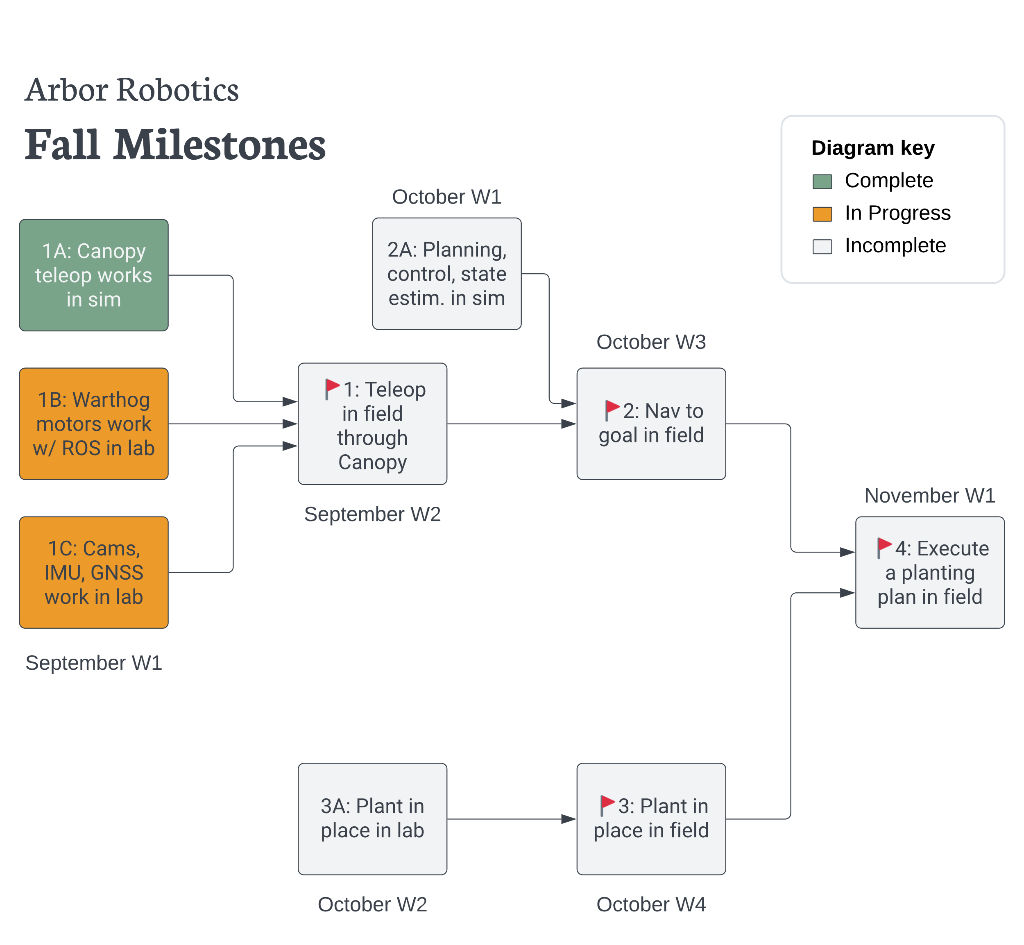
Notes:
Let’s start with the full project timeline. We started by outlining our goal, then building milestones that lead us to our goal, and finally, we construct tasks that bring us to each milestone. Milestones have deadlines. Tasks do not. Tasks are more flexible.

Slide 16
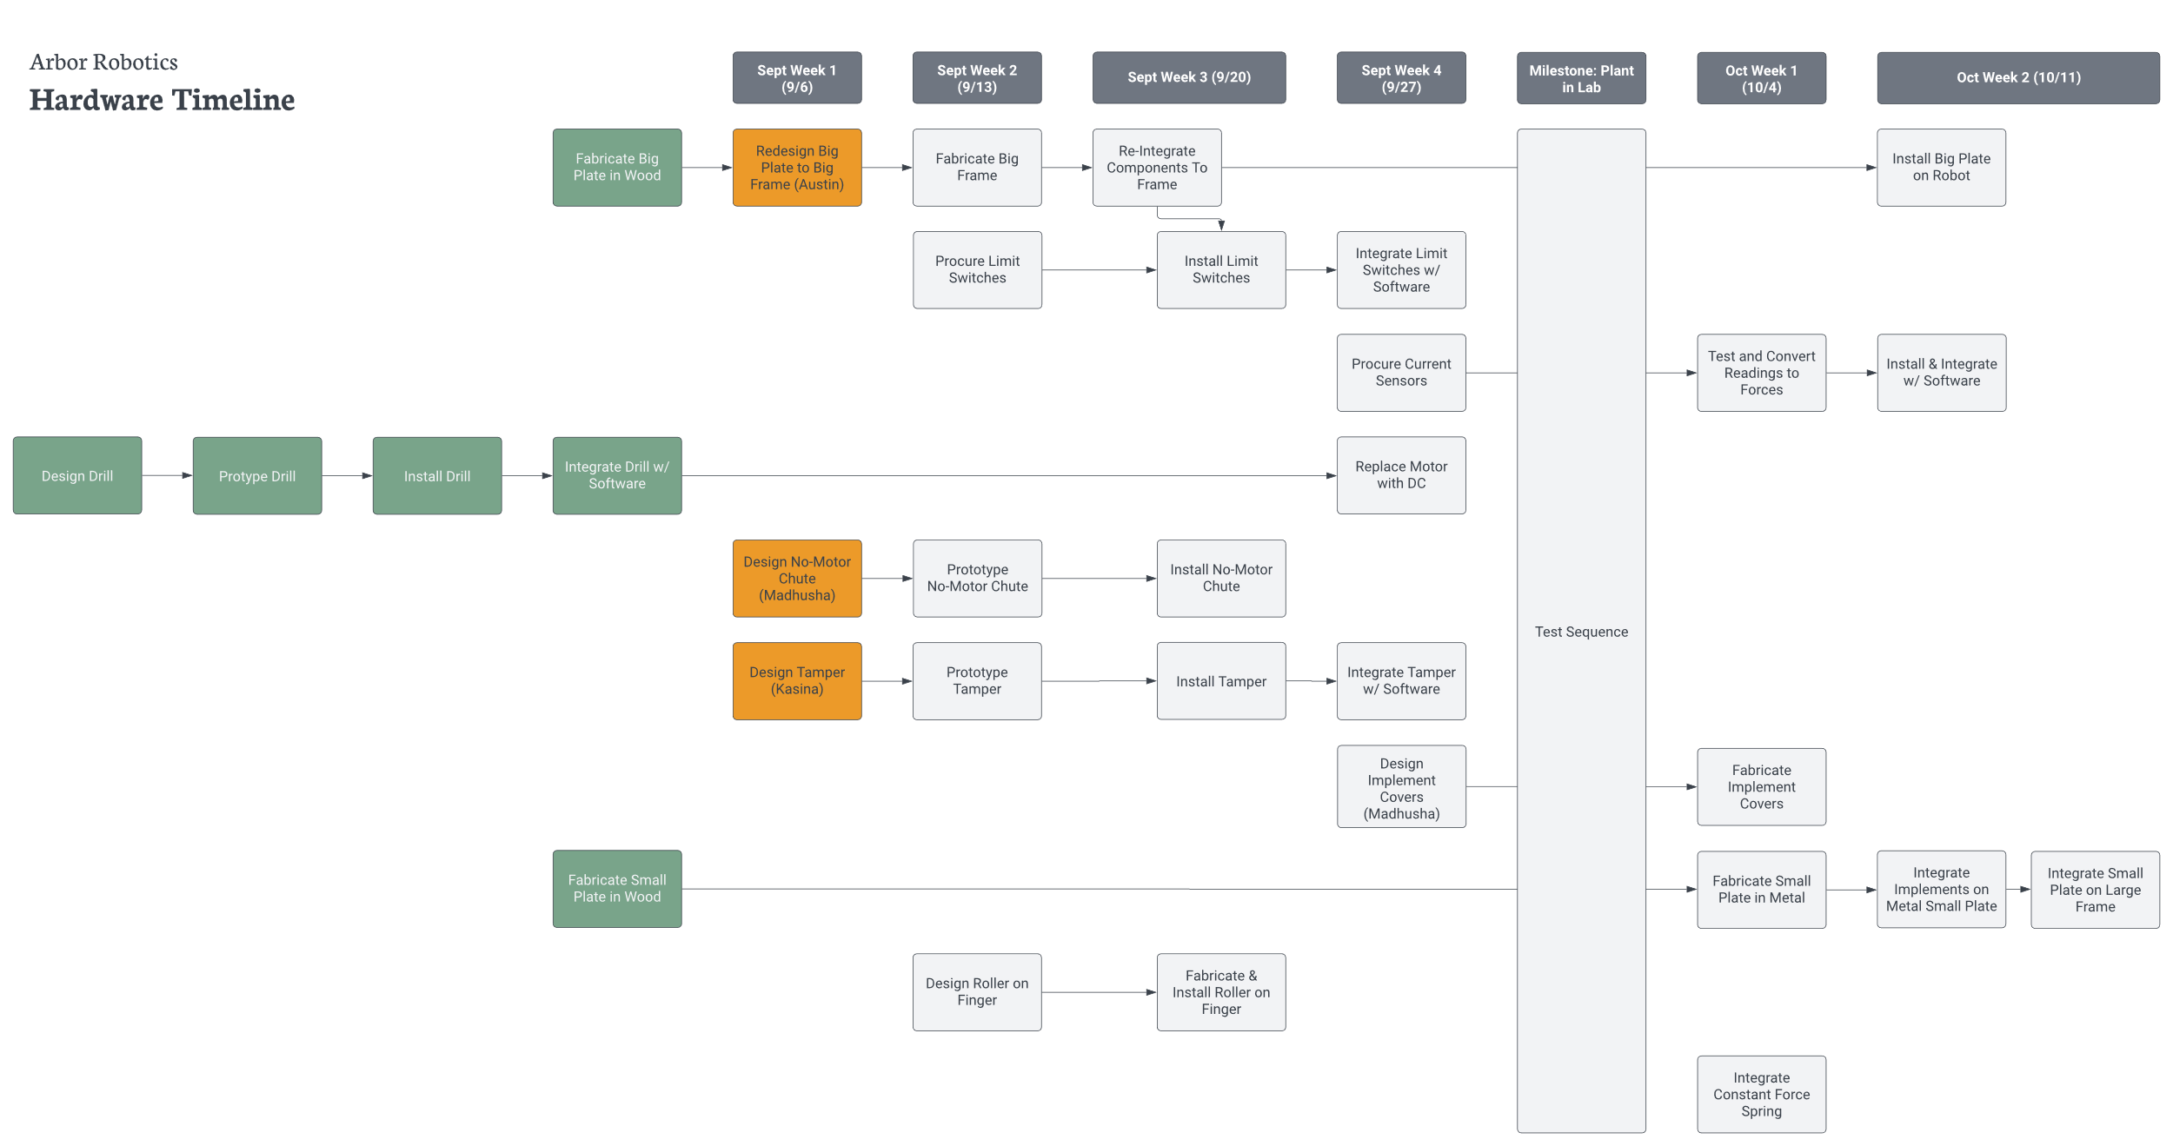

Slide 17
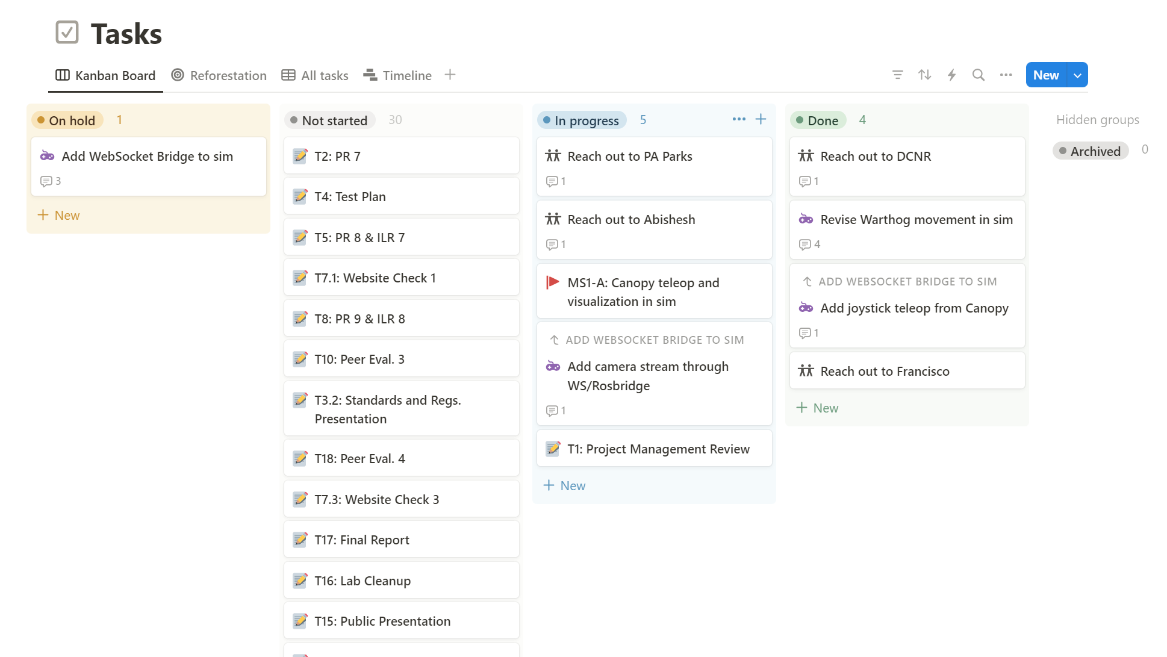

Slide 18
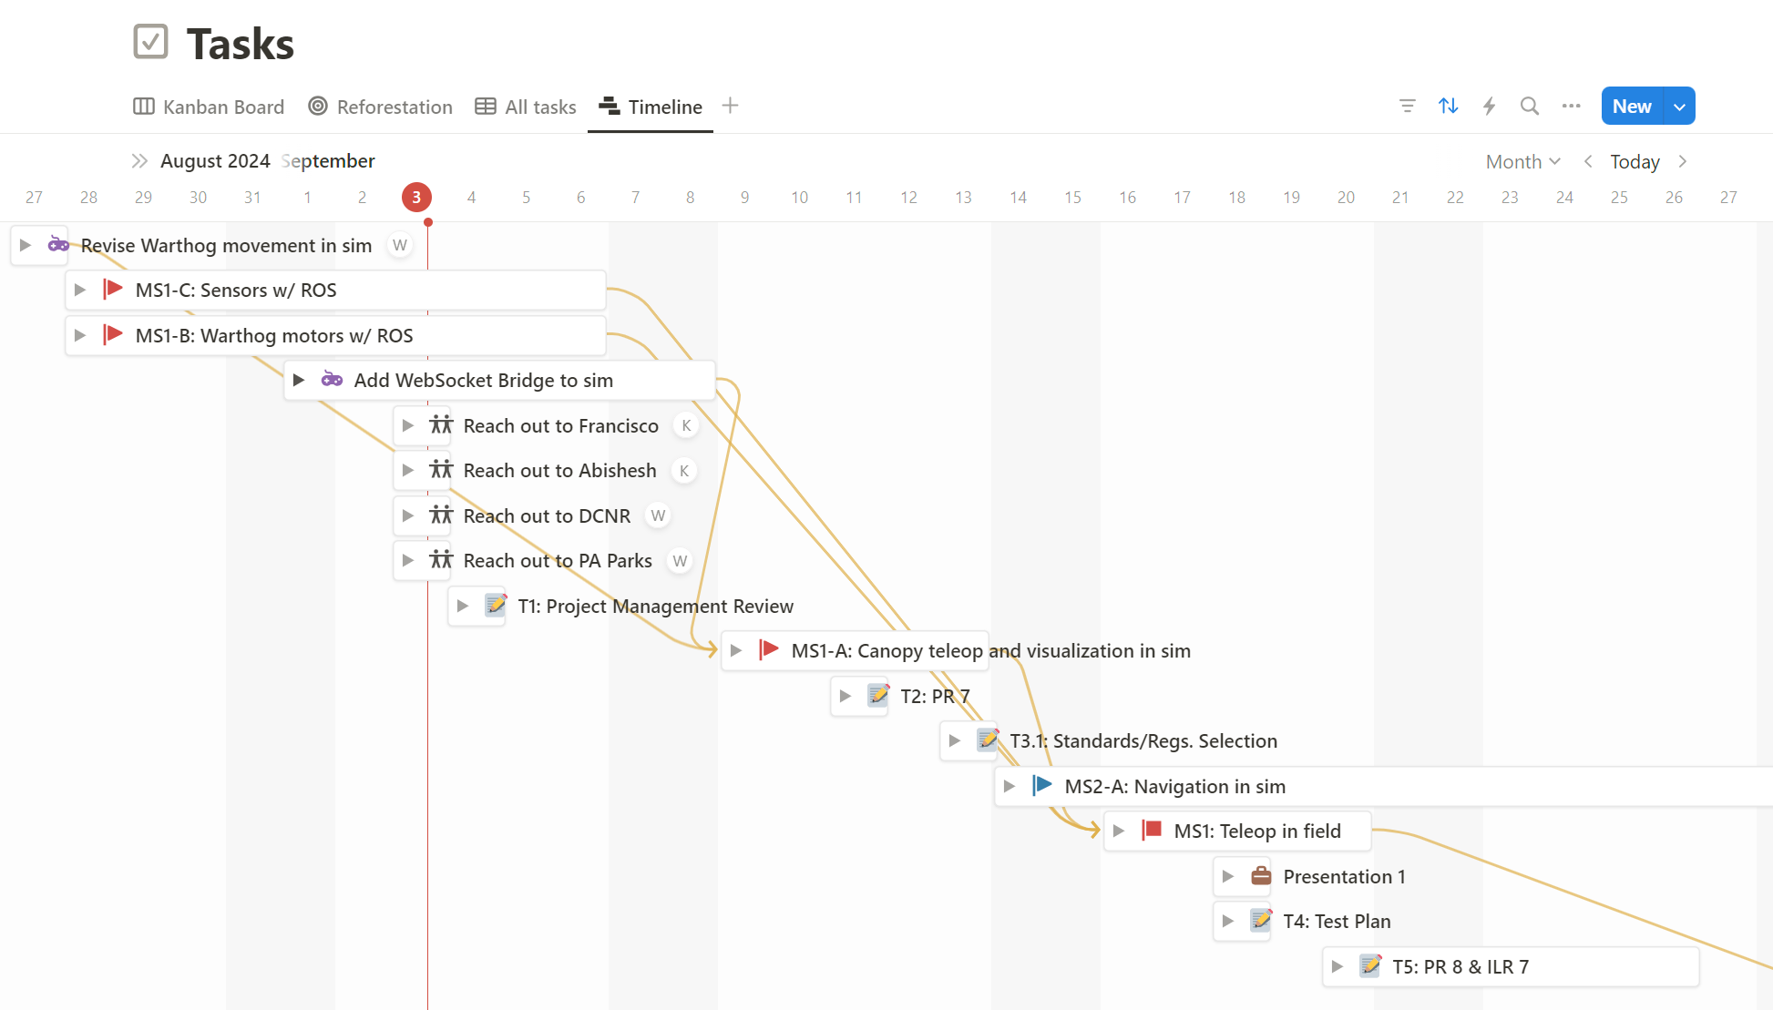

Slide 19

Meetings
One 30-minute standup each week
2 hours minimum dedicated group time
Team working in same place at same time, even on different tasks
Want team to informed/cohesive without wasting anyone’s time
Meeting structure:
Review ongoing or finished tasks
Determine new tasks, next steps
General announcements or discussion
Move directly into group time

Slide 20




Lessons & Improvements
Team was previously not as cohesive as it could have been
Project is separated into software and mechanical work
One side often did not understand what the other was doing
Learned in end that group time was helpful
Integration takes lots of time and communication
Important to reach and to update stakeholders
Domain experts (foresters)
Robotics experts (mentors in Kantor Lab)

Slide 21
Risk management
5
4
3
2
1
 | 1 | 2 | 3 | 4 | 5
Risk 1: Dust and debris infiltration
Mitigation: Design the robot with sealed enclosures and dust-resistant components and using filters or protective covers for critical areas like sensors.
R1
Likelihood
Consequences

Slide 22
Risk management
5
4
3
2
1
 | 1 | 2 | 3 | 4 | 5
Risk 2: Auger hits rock under soil surface
Mitigation: Equip the auger with a force feedback sensor that detects when it encounters an unusually hard object, automatically stopping or reversing the auger to prevent damage.
R2
R2
Likelihood
Consequences

Slide 23
Risk management
5
4
3
2
1
 | 1 | 2 | 3 | 4 | 5
Risk 3: Deformation of Planting Subsystem Frame
Mitigation: Transition from a wood to a metal frame
Likelihood
R3
R3
Consequences

Slide 24
Risk management
5
4
3
2
1
 | 1 | 2 | 3 | 4 | 5
Risk 4: Lack of access to Warthog and Testing Locations
Mitigation: Acquire set-in-stone dates and locations for testing from early discussions with the Kantor Lab
R4
R4
Likelihood
Consequences

Slide 25
Risk management
5
4 |  |  |  | R1
3 | R1* |  |  |  | R2, R4
2 | R2* |  |  |  | R3
1 |  | R3* |  | R4*
 | 1 | 2 | 3 | 4 | 5
Risk 1: Dust and debris infiltration
Mitigation: Design the robot with sealed enclosures and dust-resistant components and using filters or protective covers for critical areas like sensors.
Risk 2: Auger hits rock under soil surface
Mitigation: Equip the auger with a force feedback sensor that detects when it encounters an unusually hard object, automatically stopping or reversing the auger to prevent damage.
Risk 3: Deformation of Planting Subsystem Frame
Mitigation: Transition from a wood to a metal frame
Risk 4: Lack of access to Warthog and Testing Locations
Mitigation: Acquire set-in-stone dates and locations for testing from early discussions with the Kantor Lab
Likelihood
Consequences
(*) indicates post mitigation method

Slide 26
Thank You Q&A

